Slide 1
Lecture 10
Introduction to JavaScript

Slide 2
What is it?
JavaScript (JS) is a programming language used in a wide range of programs, including both web and game design.

Slide 3
“Hello, World” in JS
console.log(“Hello, world!”);

Slide 4
“Hello, World” in JS
console.log(“Hello, world!”);
console: where the information will be displayed

Slide 5
“Hello, World” in JS
console.log(“Hello, world!”);
console: where the information will be displayed
log(...): means ‘write this information’

Slide 6
“Hello, World” in JS
console.log(“Hello, world!”);
console: where the information will be displayed
log(...): means ‘write this information’
“Hello, world!”: the specific information to write

Slide 7
“Hello, World” in JS
console.log(“Hello, world!”);
console: where the information will be displayed
log(...): means ‘write this information’
“Hello, world!”: the specific information to write
; : marks the end of this line of code

Slide 8
Running JS in a Web Browser
In order to run JS in a browser, it must be included in an HTML file.
Either inline, external, or internal

Slide 9
Running JS in a Web Browser
In order to run JS in a browser, it must be included in an HTML file.
Either inline, external, or internal
External Solution (in a separate .JS file):
console.log(“Hello, World!”);

Slide 10
Running JS in a Web Browser
In order to run JS in a browser, it must be included in an HTML file.
Either inline, external, or internal
Internal Solution (in a .HTML file):
<script>
console.log(“Hello, World!”);
</script>

Slide 11
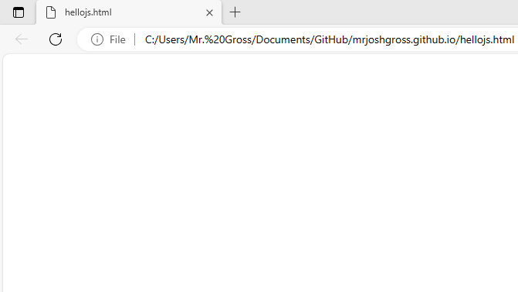
Running JS in a Web Browser
After typing the console statement into a blank .html and opening it, we see:

Slide 12
Running JS in a Web Browser
After typing the console statement into a blank .html and opening it, we see:
Where’s the message?

Slide 13
Running JS in a Web Browser
After typing the console statement into a blank .html and opening it, we see:
Where’s the message?
- The message is displayed in the console, but what we view by default is the document / body

Slide 14
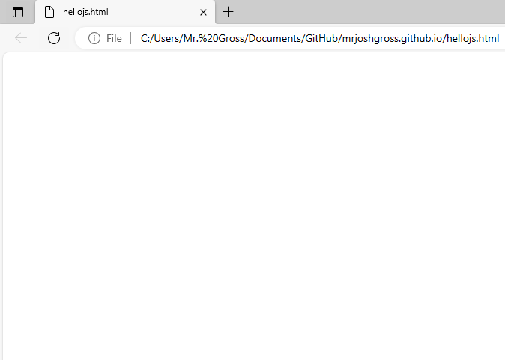
Anatomy of a Web Browser
Webpage Title
Webpage URL
Webpage Body
(aka webpage document)

Slide 15
Anatomy of a Web Browser
Webpage Title
Webpage URL
Webpage Body
(aka webpage document)
Where’s the console??

Slide 16
Anatomy of a Web Browser
Webpage Title
Webpage URL
Webpage Body
(aka webpage document)
Where’s the console??
- The console is hidden by default but is viewable by hitting the F12 button, or CTRL + SHIFT + I (i).

Slide 17
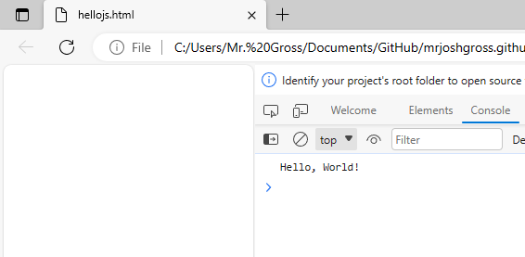
Anatomy of a Web Browser
Webpage Title
Webpage URL
Webpage Body
(aka webpage document)
Webpage Console

Slide 18
Writing to the Body (Document)
Writing to the console is good for troubleshooting purposes, but not great when trying to display information to a normal user

Slide 19
Writing to the Body (Document)
Writing to the console is good for troubleshooting purposes, but not great when trying to display information to a normal user
Writing to the body of a document is more involved

Slide 20
Writing to the Body (Document)
Writing to the console is good for troubleshooting purposes, but not great when trying to display information to a normal user
Writing to the body of a document is more involved
Things needed to write to the body of a document:
A body
Information to write (“Hello, World”)
An element (p, b, div, etc.) with an id

Slide 21
Writing to the Body (Document)
Example: Set the contents of a paragraph with an id of “writehere” to “Hello, World!”
<p id=”writehere”></p>
<script>
let pText = document.getElementById(“writehere”);
pText.innerHTML = “Hello, World!”
</script>

Slide 22
Writing to the Body (Document)
Algorithm to write to the body of a document:
Create an element with a specific id
Create a new JS script
Obtain a reference to the element to write in via it’s id and store in a variable
Set the innerHTML property of the element to the text to write to the page

Slide 23
Writing to the Body (Document)
Algorithm to write to the body of a document:
Create an element with a specific id
Create a new JS script
Obtain a reference to the element to write in via it’s id and store in a variable
Set the innerHTML property of the element to the text to write to the page
Example: Set the contents of a paragraph with an id of “writehere” to “Hello, World!”

Slide 24
Writing to the Body (Document)
Algorithm to write to the body of a document:
Create an element with a specific id
Create a new JS script
Obtain a reference to the element to write in via it’s id and store in a variable
Set the innerHTML property of the element to the text to write to the page
Example: Set the contents of a paragraph with an id of “writehere” to “Hello, World!”
<p id=”writehere”></p>

Slide 25
Writing to the Body (Document)
Algorithm to write to the body of a document:
Create an element with a specific id
Create a new JS script
Obtain a reference to the element to write in via it’s id and store in a variable
Set the innerHTML property of the element to the text to write to the page
Example: Set the contents of a paragraph with an id of “writehere” to “Hello, World!”
<p id=”writehere”></p>

Slide 26
Writing to the Body (Document)
Algorithm to write to the body of a document:
Create an element with a specific id
Create a new JS script
Obtain a reference to the element to write in via it’s id and store in a variable
Set the innerHTML property of the element to the text to write to the page
Example: Set the contents of a paragraph with an id of “writehere” to “Hello, World!”
<p id=”writehere”></p>

Slide 27
Writing to the Body (Document)
Algorithm to write to the body of a document:
Create an element with a specific id
Create a new JS script
Obtain a reference to the element to write in via it’s id and store in a variable
Set the innerHTML property of the element to the text to write to the page
Example: Set the contents of a paragraph with an id of “writehere” to “Hello, World!”
<p id=”writehere”></p>

Slide 28
Writing to the Body (Document)
Algorithm to write to the body of a document:
Create an element with a specific id
Create a new JS script
Obtain a reference to the element to write in via it’s id and store in a variable
Set the innerHTML property of the element to the text to write to the page
Example: Set the contents of a paragraph with an id of “writehere” to “Hello, World!”
<p id=”writehere”></p>
<script>
</script>

Slide 29
Writing to the Body (Document)
Algorithm to write to the body of a document:
Create an element with a specific id
Create a new JS script
Obtain a reference to the element to write in via it’s id and store in a variable
Set the innerHTML property of the element to the text to write to the page
Example: Set the contents of a paragraph with an id of “writehere” to “Hello, World!”
<p id=”writehere”></p>
<script>
let pElement = document.getElementById(“writehere”);
</script>

Slide 30
Writing to the Body (Document)
Algorithm to write to the body of a document:
Create an element with a specific id
Create a new JS script
Obtain a reference to the element to write in via it’s id and store in a variable
Set the innerHTML property of the element to the text to write to the page
Example: Set the contents of a paragraph with an id of “writehere” to “Hello, World!”
<p id=”writehere”></p>
<script>
let pElement = document.getElementById(“writehere”);
</script>

Slide 31
Writing to the Body (Document)
Algorithm to write to the body of a document:
Create an element with a specific id
Create a new JS script
Obtain a reference to the element to write in via it’s id and store in a variable
Set the innerHTML property of the element to the text to write to the page
Example: Set the contents of a paragraph with an id of “writehere” to “Hello, World!”
<p id=”writehere”></p>
<script>
let pElement = document.getElementById(“writehere”);
</script>

Slide 32
Writing to the Body (Document)
Algorithm to write to the body of a document:
Create an element with a specific id
Create a new JS script
Obtain a reference to the element to write in via it’s id and store in a variable
Set the innerHTML property of the element to the text to write to the page
Example: Set the contents of a paragraph with an id of “writehere” to “Hello, World!”
<p id=”writehere”></p>
<script>
let pElement = document.getElementById(“writehere”);
</script>

Slide 33
Writing to the Body (Document)
Algorithm to write to the body of a document:
Create an element with a specific id
Create a new JS script
Obtain a reference to the element to write in via it’s id and store in a variable
Set the innerHTML property of the element to the text to write to the page
Example: Set the contents of a paragraph with an id of “writehere” to “Hello, World!”
<p id=”writehere”></p>
<script>
let pElement = document.getElementById(“writehere”);
pElement.innerHTML = “Hello, World!”;
</script>

Slide 34
Writing to the Body (Document)
Algorithm to write to the body of a document:
Create an element with a specific id
Create a new JS script
Obtain a reference to the element to write in via it’s id and store in a variable
Set the innerHTML property of the element to the text to write to the page
Example: Set the contents of a paragraph with an id of “writehere” to “Hello, World!”
<p id=”writehere”></p>
<script>
let pElement = document.getElementById(“writehere”);
pElement.innerHTML = “Hello, World!”;
</script>

Slide 35
Writing to the Body (Document)
Algorithm to write to the body of a document:
Create an element with a specific id
Create a new JS script
Obtain a reference to the element to write in via it’s id and store in a variable
Set the innerHTML property of the element to the text to write to the page
Example: Set the contents of a paragraph with an id of “writehere” to “Hello, World!”
<p id=”writehere”></p>
<script>
let pElement = document.getElementById(“writehere”);
pElement.innerHTML = “Hello, World!”;
</script>

Slide 36
Writing to the Body (Document)
Algorithm to write to the body of a document:
Create an element with a specific id
Create a new JS script
Obtain a reference to the element to write in via it’s id and store in a variable
Set the innerHTML property of the element to the text to write to the page
Example: Set the contents of a paragraph with an id of “writehere” to “Hello, World!”
<p id=”writehere”></p>
<script>
let pElement = document.getElementById(“writehere”);
pElement.innerHTML = “Hello, World!”;
</script>

Slide 37
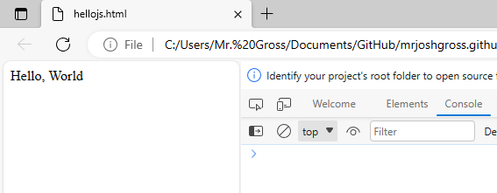
Writing to the Body (Document)
Algorithm to write to the body of a document:
Create an element with a specific id
Create a new JS script
Obtain a reference to the element to write in via it’s id and store in a variable
Set the innerHTML property of the element to the text to write to the page
Example: Set the contents of a paragraph with an id of “writehere” to “Hello, World!”
<p id=”writehere”></p>
<script>
let pElement = document.getElementById(“writehere”);
pElement.innerHTML = “Hello, World!”;
</script>
“Hello, World” now in the body of the document, not in the console

Slide 38
Writing to the Body (Document)
Algorithm to write to the body of a document:
Create an element with a specific id
Create a new JS script
Obtain a reference to the element to write in via it’s id and store in a variable
Set the innerHTML property of the element to the text to write to the page
Exercises
Set the contents of a div with an id of “container” to “You can’t contain me!”
Set the contents of a span with an id of “name” to “Scott Calvin”
Set the contents of a paragraph with an id of “part1” to “Wait until the second half...” Then, print “...when the curtain falls!” to the console

Slide 39
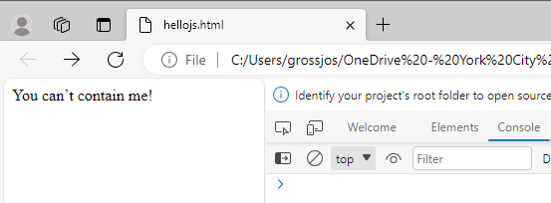
Writing to the Body (Document)
Algorithm to write to the body of a document:
Create an element with a specific id
Create a new JS script
Obtain a reference to the element to write in via it’s id and store in a variable
Set the innerHTML property of the element to the text to write to the page
Exercises
Set the contents of a div with an id of “container” to “You can’t contain me!”
<div id=”container”></div>
<script>
let divElement = document.getElementById(“container”);
divElement.innerHTML = “You can’t contain me!”;
</script>

Slide 40
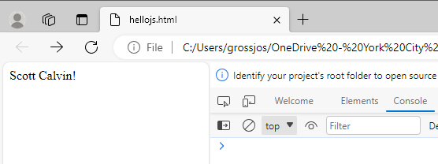
Writing to the Body (Document)
Algorithm to write to the body of a document:
Create an element with a specific id
Create a new JS script
Obtain a reference to the element to write in via it’s id and store in a variable
Set the innerHTML property of the element to the text to write to the page
Exercises
Set the contents of a span with an id of “name” to “Scott Calvin”
<span id=”name”></span>
<script>
let spanElement = document.getElementById(“name”);
spanElement.innerHTML = “Scott Calvin!”;
</script>

Slide 41
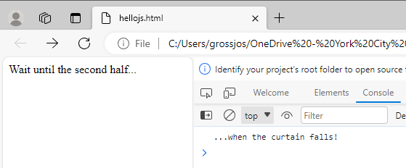
Writing to the Body (Document)
Algorithm to write to the body of a document:
Create an element with a specific id
Create a new JS script
Obtain a reference to the element to write in via it’s id and store in a variable
Set the innerHTML property of the element to the text to write to the page
Exercises
Set the contents of a paragraph with an id of “part1” to “Wait until the second half...” Then, print “...when the curtain falls!” to the console
<p id=”part1”></p>
<script>
let pElement= document.getElementById(“part1”);
pElement.innerHTML = “Wait until the second half...”;
console.log(“...when the curtain falls!”);
</script>

